Slide 1

Characterization of Power Usage and Performance in Data-Intensive Applications using MapReduce over MPI
Joshua DAVIS a , Tao GAO a , Sunita CHANDRASEKARAN a , Heike JAGODE b ,
Anthony DANALIS b , Jack DONGARRA b , Pavan BALAJI c , and Michela TAUFER b
a University of Delaware
b University of Tennessee Knoxville
c Argonne National Laboratory

Slide 2
Trends in Next-Generation Systems
Widening I/O Gap
Rising Importance of Ensembles
Exascale
64x
Sierra (2018)
System Scale (FLOPS)
Petascale
Sequoia (2013)
Purple (2005)
12x
13x
Terascale
5x
Few
Many
Number of Jobs
Source: Lucy Nowell (DOE)
Source: https://wci.llnl.gov/simulation/computer-codes/uncertainty-quantification
2
Notes:
Floating point operations will further increase
Speed to move data down the memory hierarchy is stagnant

Slide 3
Canonical Data Processing
MapReduce runtime handles the parallel job execution, communication, and data movement
Users provide map and reduce functions
Wordcount example:
<Hello,1>
Hello
World
<world,1>
reduce
<Hello, 2>
map
Shuffle
Hello
World
map
reduce
<World, 2>
<Hello,1>
<world,1>
3

Slide 4

WordCount Benchmark
Map
Key
Value
When tweetle beetles fight,
it’s called a tweetle beetle battle.
And when they battle in a puddle,
it’s a tweetle beetle puddle battle.
And when tweetle beetles battle with paddles in a puddle,
They call it a tweetle beetle puddle paddle battle.
(When, 1), (tweetle, 1), (beetles, 1), (fight, 1)
(it’s, 1), (called, 1), (a, 1), (tweetle, 1), (beetle, 1), (battle, 1)
(And, 1), (when, 1), (they, 1), (battle, 1), (in, 1), (a, 1), (puddle, 1)
(it’s, 1), (a, 1), (tweetle, 1), (beetle, 1), (puddle, 1), (battle, 1)
(And, 1), (when, 1), (tweetle, 1), (beetles, 1), (battle, 1),
(with, 1), (paddles, 1), (in, 1), (a, 1), (puddle, 1)
(They, 1), (call, 1), (it, 1), (a, 1), (tweetle, 1), (beetle, 1),
(puddle, 1), (paddle, 1), (battle, 1)

Slide 5
WordCount Benchmark
Reduce
Sort/Shuffle
(tweetle, 1), (tweetle, 1), (tweetle, 1), (tweetle, 1), (tweetle, 1)
(tweetle, 5)
(When, 1), (tweetle, 1), (beetles, 1), (fight, 1)
(it’s, 1), (called, 1), (a, 1), (tweetle, 1), (beetle, 1), (battle, 1)
(And, 1), (when, 1), (they, 1), (battle, 1), (in, 1), (a, 1), (puddle, 1)
(it’s, 1), (a, 1), (tweetle, 1), (beetle, 1), (puddle, 1), (battle, 1)
(And, 1), (when, 1), (tweetle, 1), (beetles, 1), (battle, 1),
(with, 1), (paddles, 1), (in, 1), (a, 1), (puddle, 1)
(They, 1), (call, 1), (it, 1), (a, 1), (tweetle, 1), (beetle, 1),
(puddle, 1), (paddle, 1), (battle, 1)
(When, 1)
(When, 1)
(when, 1), (when, 1)
(when, 2)
(battle, 1), (battle, 1), (battle, 1), (battle, 1), (battle, 1)
(battle, 5)
(puddle, 1), (puddle, 1), (puddle, 1), (puddle, 1)
(puddle, 4)
(beetle, 1), (beetle, 1), (beetle, 1)
(beetle, 3)
(beetles, 1), (beetles, 1)
(beetles, 2)

Slide 6
Data Processing: Cloud vs. HPC
Key differences between Cloud computing and HPC systems disenfranchise the naïve used of Cloud method
Cloud computing systems
HPC systems
disk
processor
OS
processor
Interconnect
OS
Ethernet
processor
disk
array
disk
Storage
Storage
Hadoop/Spark
MPI/OpenMP

Slide 7
Programming Models Evolve
Y over ( MPI + X )
From John Barr (2013)
https://www.scientific-computing.com/news/analysis-opinion/software-development-standards-next-generation-hpc-systems

Slide 8
Programming Models Evolve
Y over ( MPI + X )
X: C / Fortran
OpenMP
OpenACC
UPC
CUDA
….
From John Barr (2013)
https://www.scientific-computing.com/news/analysis-opinion/software-development-standards-next-generation-hpc-systems

Slide 9
Programming Models Evolve
Y over ( MPI + X )
Y: MapReduce
In situ analysis
In transit analysis
….
X: C / Fortran
OpenMP
OpenACC
UPC
CUDA
….
From John Barr (2013)
https://www.scientific-computing.com/news/analysis-opinion/software-development-standards-next-generation-hpc-systems

Slide 10
over MPI
Is MapReduce an effective way
to handle big data processing on HPC systems?
10

Slide 11
MR-MPI Implementation
Support logical map-shuffle-reduce workflow in four phases:
Map, aggregate, convert, and reduce [1]
input
<key, value>
<key, value>
<key, list<value>>
output
P0
aggregate
convert
reduce
map
P1
map
convert
reduce
…
…
…
…
…
Pn
map
convert
reduce
barrier
barrier
barrier
barrier
S. J Plimpton and K. D. Devine. MapReduce in MPI for Large-Scale Graph Algorithms. Parallel Computing, 37(9):610–632, 2011.

Slide 12
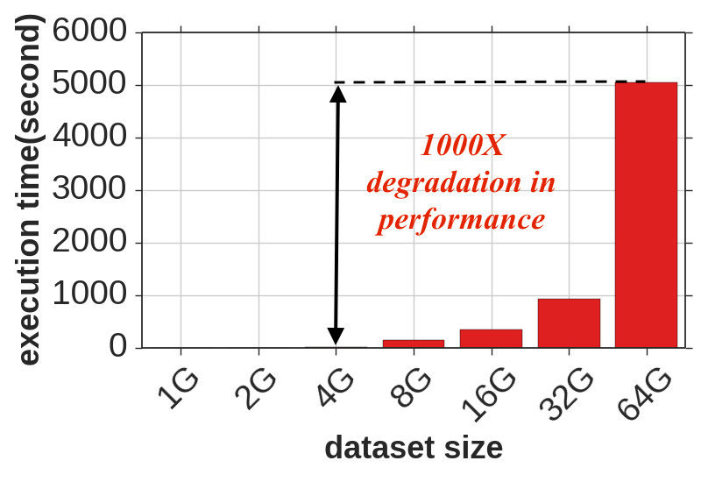
Limits of Existing MapReduce over MPI
State-of-art MapReduce over MPI is MapReduce-MPI (MR-MPI)
BUT MapReduce-MPI does not use memory efficiently
Can process only 4GB data in-memory on a 128GB node
Out-of-memory
processing
Single-node execution time of WordCount (Wikipedia) with MR-MPI on Comet (128G memory).
S. J Plimpton and K. D. Devine. MapReduce in MPI for Large-Scale Graph Algorithms. Parallel Computing, 37(9):610–632, 2011.
12
Notes:
Floating point operations will further increase
Speed to move data down the memory hierarchy is stagnant

Slide 13
Mimir Implementation
Interleave operations: e.g., map interleaves with aggregate
interleave
input
<key, value>
<key,value>
<key,list<value>>
output
P0
aggregate
convert
reduce
map
P1
map
convert
reduce
…
…
…
…
…
Pn
map
convert
reduce
barrier
barrier
barrier
T. Gao, Y. Guo, B. Zhang, P. Cicotti, Y. Lu, P. Balaji, and M. Taufer. Mimir: Memory-Efficient and Scalable MapReduce for Large Supercomputing Systems. In Proceedings of the IPDPS, 2017.

Slide 14
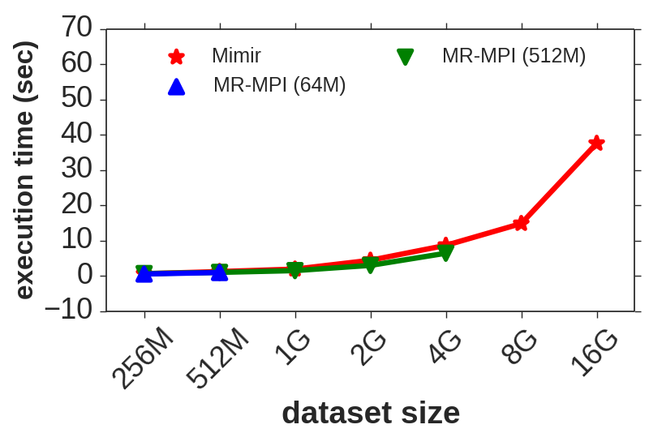
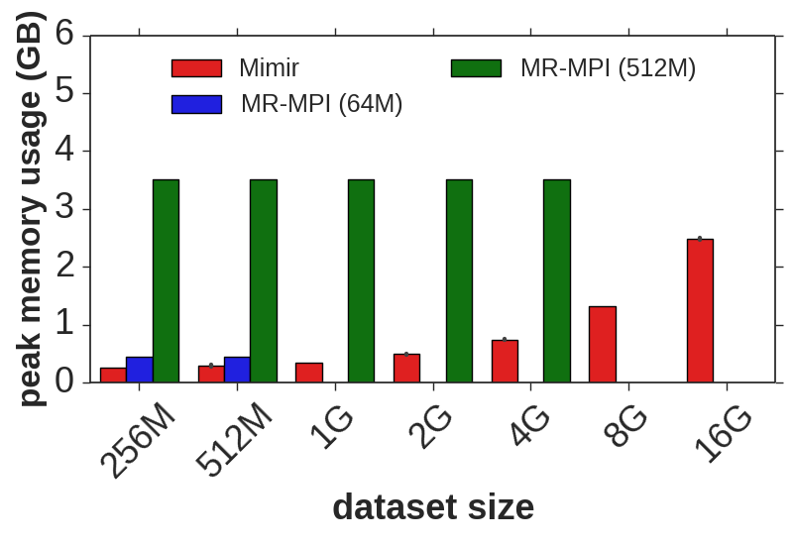
Results: WordCount
Benchmarks: WordCount (WC) – single-pass MapReduce application with associative and commutative reduce function; Datasets - Wikipedia dataset
HPC System: Tianhe-2: compute node with two Intel Xeon E2-2692v2 CPUs (12 cores each, 24 cores total) running at 2.2 GHz. Each node has 64 GB of memory
Settings: MR-MPI (64M page and 512M page); Mimir (64M page)
4X
64X
T. Gao, Y. Guo, B. Zhang, P. Cicotti, Y. Lu, P. Balaji, and M. Taufer. Mimir: Memory-Efficient and Scalable MapReduce for Large Supercomputing Systems. In Proceedings of the IPDPS, 2017.
14

Slide 15
Data Load Imbalance
<key,value> pairs are NOT distributed evenly among processes
Imbalanced <key,value> pairs may cause poor resource usage
Number of <key,value> pairs for the WordCount (Wikipedia) on 768 processes
Mimir
Mimir
Balance ratio
Total time (sec)
Number of <key,value> pairs
Balance ratio (Max mem / min mem for all processes) for WordCount (Wikipedia) on Tianhe-2
Execution time of WordCount (Wikipedia) with Mimir on Tianhe-2 without load balancing
Process ids
15

Slide 16
Combining <key,value> Pairs
Merge <key,value> pairs with the same key before shuffle
Merge <key,value> pairs with the same key after shuffle
Wordcount example:
Hello
World
Hi
World
<Hello,1>
<World,1>
reduce
<Hello, 3>
map
<World,2>
<Hello,2>
<Hi,1>
<World,1>
Hello
World
Shuffle
<Hello,1>
map
reduce
<World, 3>
<World,1>
Hello
reduce
<Hi, 1>
map
<Hello,1>
T. Gao, Y. Guo, B. Zhang, P. Cicotti, Y. Lu, P. Balaji, and M. Taufer. On the Power of Combiner Optimizations in MapReduce over MPI Workflows. ICPADS, 2018.

Slide 17
Combining <key,value> Pairs
Combiner operations:
Merge <key,value> pairs with the same key before shuffle
Merge <key,value> pairs with the same key after shuffle
Application dependent:
Wordcount → YES
Join → NO
input
<key, value>
aggregate
P0
map
combine
combine
P1
map
…
…
combine
combine
Pn
map
combine
combine
T. Gao, Y. Guo, B. Zhang, P. Cicotti, Y. Lu, P. Balaji, and M. Taufer. On the Power of Combiner Optimizations in MapReduce over MPI Workflows. ICPADS, 2018.
17

Slide 18
Results: Word Counting
Benchmarks: WordCount (WC) – single-pass MapReduce application with associative and commutative reduce function
HPC System: Tianhe-2: compute node with two Intel Xeon E2-2692v2 CPUs (12 cores each, 24 cores total) running at 2.2 GHz. Each node has 64 GB of memory
Dataset: Synthetic words (24 GB/node)
T. Gao, Y. Guo, B. Zhang, P. Cicotti, Y. Lu, P. Balaji, and M. Taufer. On the Power of Combiner Optimizations in MapReduce over MPI Workflows. ICPADS, 2018.

Slide 19
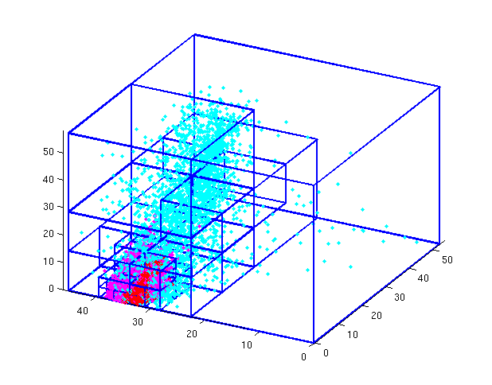
Results: Octree Clustering
Benchmark: Octree Clustering (OC) – iterative chain of MR jobs
HPC System: Tianhe-2: compute node with two Intel Xeon
E2-2692v2 CPUs (12 cores each, 24 cores total) running at
2.2 GHz. Each node has 64 GB of memory
Data: synthetic points (2²⁹ points/node)
T. Gao, Y. Guo, B. Zhang, P. Cicotti, Y. Lu, P. Balaji, and M. Taufer. On the Power of Combiner Optimizations in MapReduce over MPI Workflows. ICPADS, 2018.

Slide 20
Results: Join
Benchmark: Join
HPC System: Tianhe-2: compute node with two Intel Xeon E2-2692v2 CPUs (12 cores each, 24 cores total) running at 2.2 GHz. Each node has 64 GB of memory
Data: large dataset (log dataset) join small dataset (reference dataset)
T. Gao, Y. Guo, B. Zhang, P. Cicotti, Y. Lu, P. Balaji, and M. Taufer. On the Power of Combiner Optimizations in MapReduce over MPI Workflows. ICPADS, 2018.

Slide 21
Dynamic Repartition: Dealing with Skew Data
T. Gao, Y. Guo, B. Zhang, P. Cicotti, Y. Lu, P. Balaji, and M. Taufer. Scalable Data Skew Mitigation in MapReduce over MPI for Supercomputing Systems. IEEE TPDS, 2019.
21
Notes:
Perform KVs repartition once imbalance problem is detected in KVC
Application independent

Slide 22
Results: Join
Benchmark: Join
HPC System: Tianhe-2: compute node with two Intel Xeon E2-2692v2 CPUs (12 cores each, 24 cores total) running at 2.2 GHz. Each node has 64 GB of memory
Data: large dataset (log dataset) join small dataset (reference dataset)
Data distribution: from value-balanced to value imbalanced-datasets
T. Gao, Y. Guo, B. Zhang, P. Cicotti, Y. Lu, P. Balaji, and M. Taufer. Scalable Data Skew Mitigation in MapReduce over MPI for Supercomputing Systems. IEEE TPDS, 2019.

Slide 23
Split Workflows: Dealing with Superkeys
T. Gao, Y. Guo, B. Zhang, P. Cicotti, Y. Lu, P. Balaji, and M. Taufer. Scalable Data Skew Mitigation in MapReduce over MPI for Supercomputing Systems. IEEE TPDS, 2019.
23
Notes:
Perform KVs repartition once imbalance problem is detected in KVC
Application independent

Slide 24
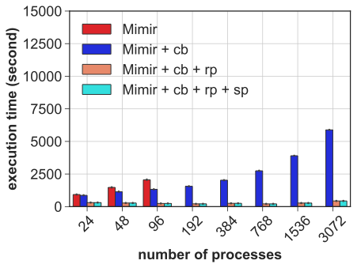
Results: Octree Clustering
Optimizations:
Combiner Optimizations
Dynamic Partition
Superkeys and Splitting
Benchmarks:
Word count (WC)
Octree clustering (OC)
Breadth-first search (BFS)
Join
System: Tianhe-2
T. Gao, Y. Guo, B. Zhang, P. Cicotti, Y. Lu, P. Balaji, and M. Taufer. Scalable Data Skew Mitigation in MapReduce over MPI for Supercomputing Systems. IEEE TPDS, 2019.
24

Slide 25
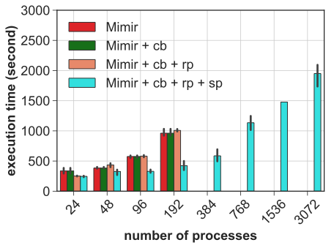
Results: Join
Optimizations:
Combiner Optimizations
Dynamic Partition
Superkeys and Splitting
Benchmarks:
Word count (WC)
Octree clustering (OC)
Breadth-first search (BFS)
Join
System: Tianhe-2
T. Gao, Y. Guo, B. Zhang, P. Cicotti, Y. Lu, P. Balaji, and M. Taufer. Scalable Data Skew Mitigation in MapReduce over MPI for Supercomputing Systems. IEEE TPDS, 2019.
25

Slide 26
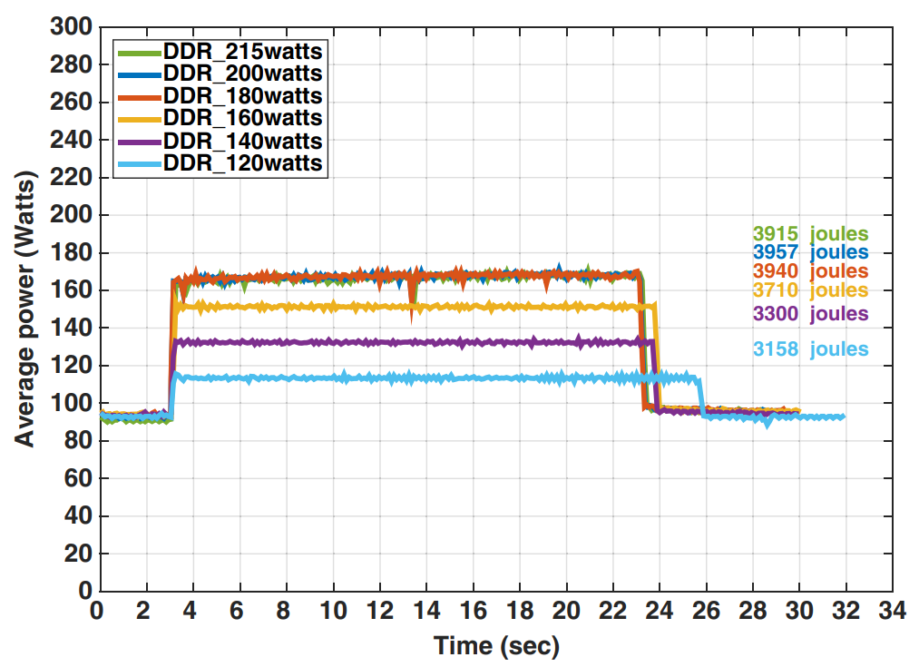
Compute-intensive Applications
HPCG Benchmark — Average Power (Dongarra)
Dongarra and co-authors studied impact of power cap on compute-intensive applications
Can we assess the same impacts on data-intensive applications?
A. Haidar et al., “Investigating power capping toward energy-efficient scientific applications,” Concurrency Computat Pract Exper. 2018; e4485. doi: 10.1002/cpe.4485
26

Slide 27
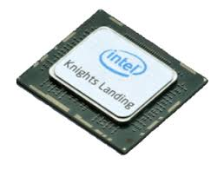
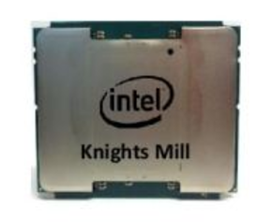
Data-intensive Applications
Data
Documents (words)
Mini-apps
WC, OC, BFS, Join
MapReduce over MPI
Mimir
MPI
Message Passing Library
Node (KNL: 68, KNM: 72 cores)
27

Slide 28
Data-intensive Applications
Data
Documents (words)
Mini-apps
GroupByKey, ReduceByKey
MapReduce over MPI
Mimir
PAPI
Tools for POWER measurement and capping
MPI
Message Passing Library
Node (KNL: 68, KNM: 72 cores)
28

Slide 29
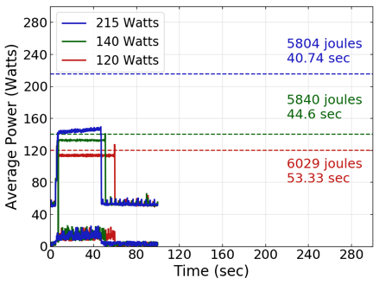

Mimir: Power Measurement and Capping
J. Davis T. Gao, S. Chandrasekaran, H. Jagode, Anthony Danalis, B. Pavan, J. Dongarra, and M. Taufer. Characterization
of Power Usage and Performance in Data-Intensive Applications using MapReduce over MPI. ParCo, 2019.

Slide 30
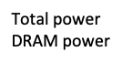
Mimir: Power Measurement and Capping
Energy Usage
Runtime
Power Caps
J. Davis T. Gao, S. Chandrasekaran, H. Jagode, Anthony Danalis, B. Pavan, J. Dongarra, and M. Taufer. Characterization
of Power Usage and Performance in Data-Intensive Applications using MapReduce over MPI. ParCo, 2019.

Slide 31
Mimir: Power Measurement and Capping
Impacts studies:
Data:
Data combinability
Mimir:
Combiner optimizations
MapReduce stages
Communication Buffering
Hardware:
Architectures (i.e., KNM, KNL)
J. Davis T. Gao, S. Chandrasekaran, H. Jagode, Anthony Danalis, B. Pavan, J. Dongarra, and M. Taufer. Characterization
of Power Usage and Performance in Data-Intensive Applications using MapReduce over MPI. ParCo, 2019.

Slide 32
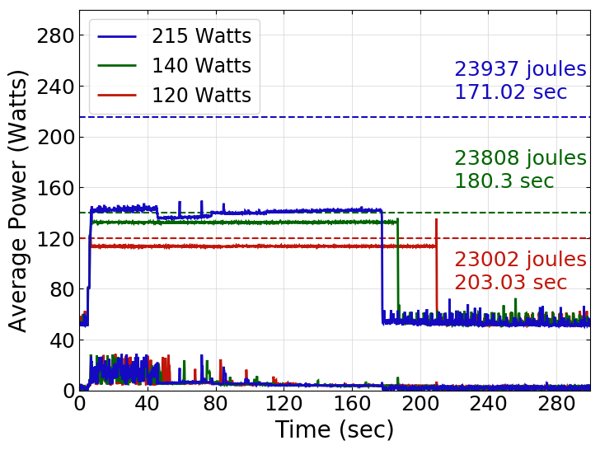
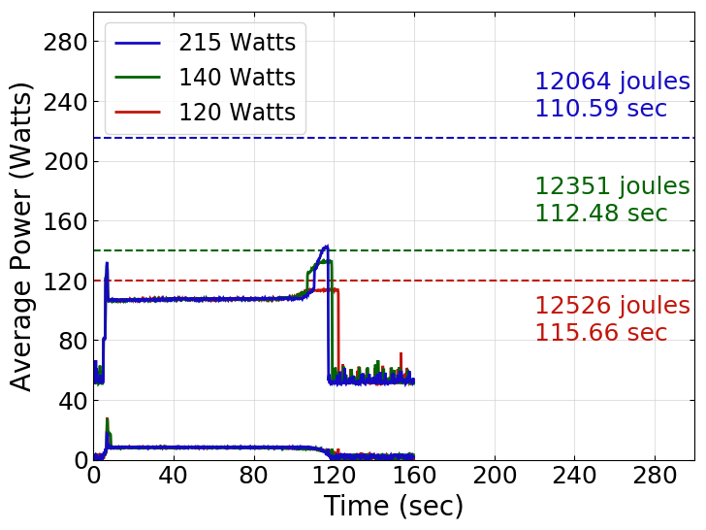
Impact of Combiner Optimizations
Data exhibits up to a 99% combinability rate before the shuffling
Optimizations:
W/o local combiner
With local combiner
Benchmarks:
Word count (WC)
System:
KNM (72 cores) + PAPI
Data:
4 billion words
72 unique words (4B72)
Without local combiner
With local combiner
Local combiner optimizations save up to 50% energy

Slide 33
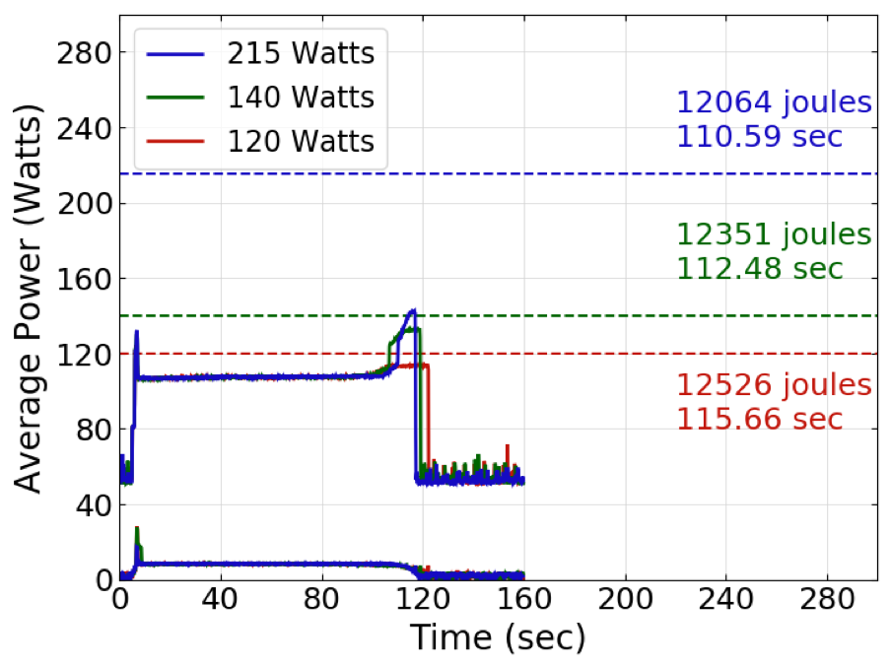
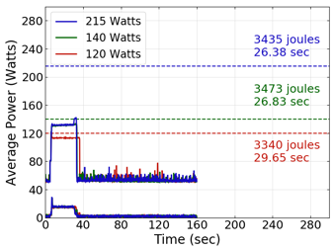
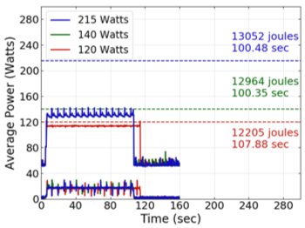
Impact of Data Combinability
Data combinability ranges from 99% (4B72) to 10% (4B50M)
4B words; 72 unique words
4B words; 5k unique words
4B words; 50M unique words
Given a datasets, we can save up to 73% reduction energy consumption at ‘sweet spots’
J. Davis T. Gao, S. Chandrasekaran, H. Jagode, Anthony Danalis, B. Pavan, J. Dongarra, and M. Taufer. Characterization
of Power Usage and Performance in Data-Intensive Applications using MapReduce over MPI. ParCo, 2019.
33

Slide 34
Impact of Communication Buffering
Mimir buffer size is used as local memory
16 MB 4B42M
128 MB 4B42M
J. Davis T. Gao, S. Chandrasekaran, H. Jagode, Anthony Danalis, B. Pavan, J. Dongarra, and M. Taufer. Characterization
of Power Usage and Performance in Data-Intensive Applications using MapReduce over MPI. ParCo, 2019.

Slide 35
Lessons Learned (I)
Mimir, a MapReduce over MPI framework
Its memory-aware implementation makes Mimir scalable on supercomputers
Quantitative evaluation of power usage over time in data-intensive applications
Power cap impacts performance of mini-apps
Local combiner optimizations saves up to 50% energy consumed
Relevance of data characteristics to energy consumption
Up to 73% reduction energy consumption at ‘sweet spot’
More intense memory energy usage at large numbers of unique words

Slide 36
Lessons Learned (II)
Different trends for performance and power usage patterns
Aspects such as data characterizes, Mimir configuration, and hardware platforms differently impact permeance and power patterns
Building a predictive, comprehensive model for data handling
Can we build a model that captures power usage as function of the diverse aspects characterizing intensive applications?

